Slide 1

Generative Adversarial Networks
Presented by Steven Kundert and Shenglin Sun

Slide 2
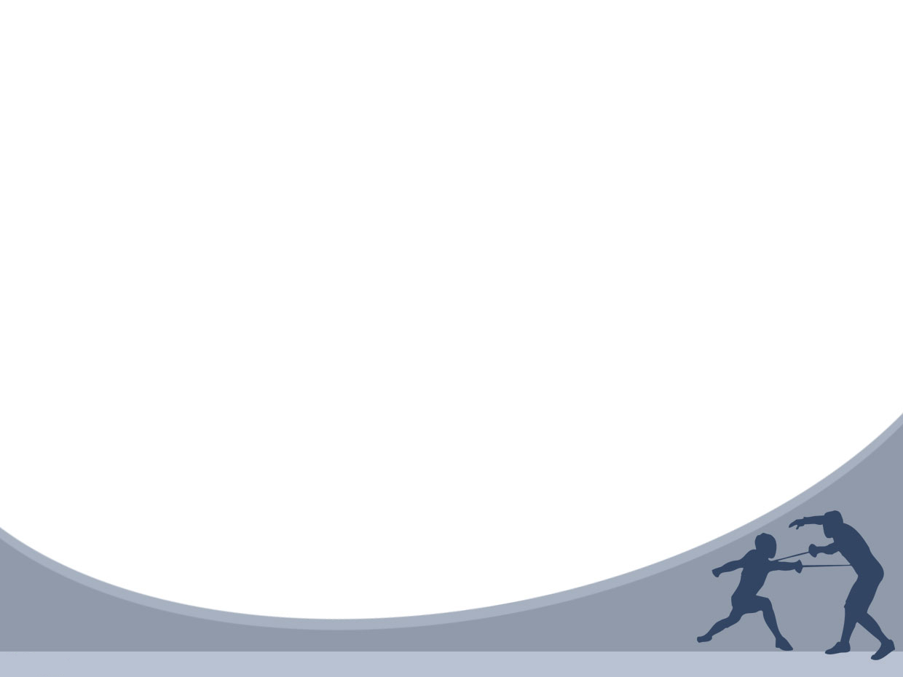
Outline
Introduction
Related Work
Adversarial Nets
Theoretical Results
Experiments
Advantages and Disadvantages
Conclusions and Future Work

Slide 3
Introduction
Deep learning has been used to model artificial intelligence
Most successful deep learning involves discriminative models that map input into class labels
Based on back-propagation and dropout algorithms using weight and bias vectors with well-behaved gradients

Slide 4
Introduction (cont’d)
Deep generative models have had less success
Difficult to leverage usefulness of weight and bias vectors
In an adversarial net, a generative model is pitted against an discriminative model that learns to tell whether a sample is real or fake

Slide 5
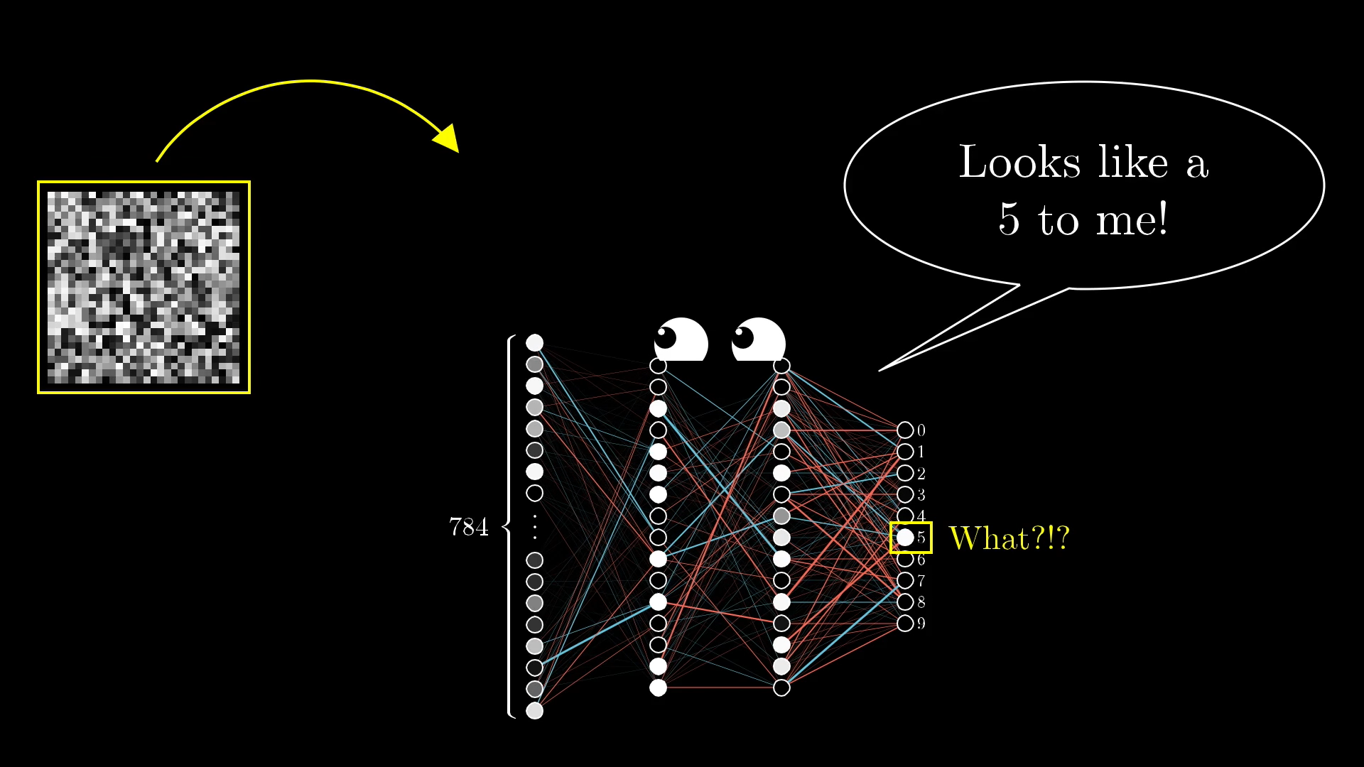
What happens when random data is input into the discriminative model?
The model thinks that the random data fits into the class ‘5’

Slide 6
Intro (cont’d)
Consider a trained CNN that works well on ImageNet data
Take a sample image and manipulate it so that the prediction error is maximized
The predicted classification of the image will change, while the image looks similar to the original
An adversarial image is one that will fool a CNN

Slide 7
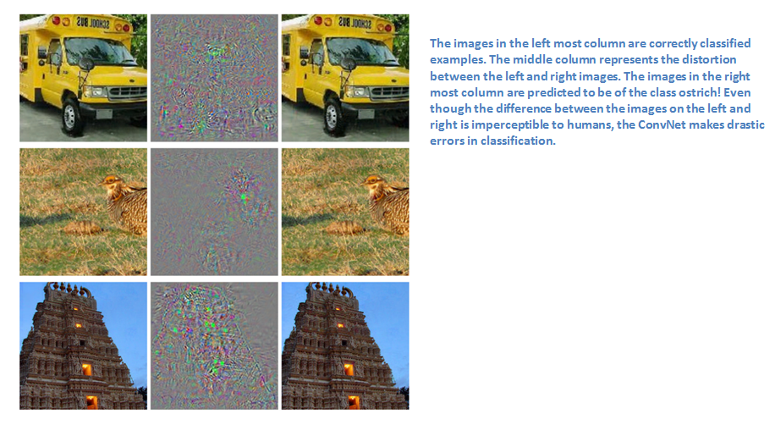

Slide 8
Generative Adversarial Networks
Create a generative model that generates samples by passing random noise through a multilayer perceptron
Create a discriminative model that is also a multilayer perceptron
Train both models using back-propagation and dropout algorithms
Sample from the generative model using forward propagation

Slide 9

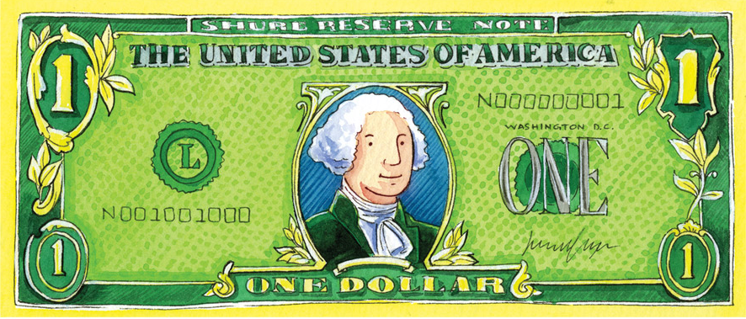
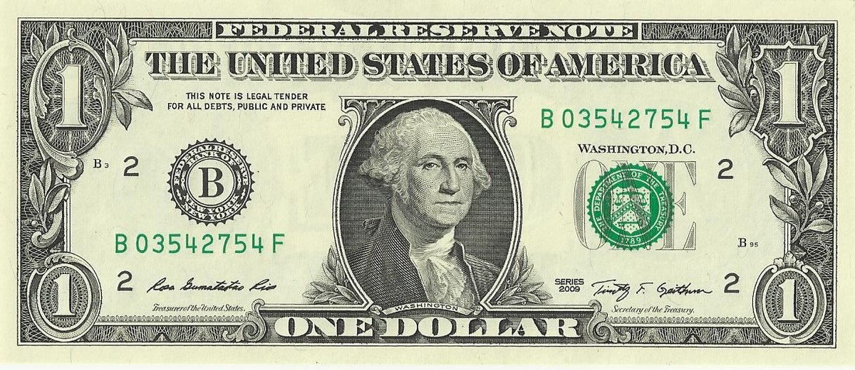

Example
Generative model acts like a currency counterfeiter
Discriminative model acts like police trying to catch counterfeits
Competition drives both to improve their methods until counterfeit is identical to real thing

Slide 11
Theoretical Results

Slide 13
Experiment

Slide 15
Advantages and Disadvantages

Slide 17
Conclusions and Future Work

